Slide 1
Karagoz Theatre (Turkey)

Slide 2
Theatre in context
Introduced from Egypt by Yavuz Sultan Selim. Others say it originates from Indonesia. Yet another theory says that it originated in the fourteenth century.
Popular, witty, folk hero who has always commented on social events and poked fun at authority with comedy combining satire, play on words, double meanings and exaggerations.
Performances conclude with an apology to the audience for any errors made during the show.

Slide 3
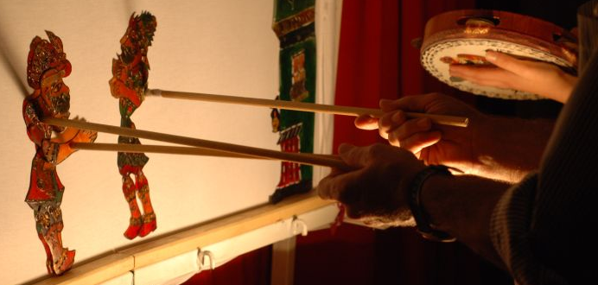
Puppets are jointed between 30 and 40cm high and can be made from camel or cow hide which is made translucent by treatment. Some suggest that original puppets were made from leather slippers. Details of the puppet are cut with sharp blades and colour is added with Indian inks or natural dyes.
Scenery is depicted by sets that have been cut-out and placed on the sides of the screen (meaning ‘mirror’) and can be interchangeable. Instruments such as cymbals and pipes are kept on a wooden ledge behind and below the screen. This same ledge is used to hold electric lights.
Performances are done by one person who may have an assistant. This person operates all characters, speaks as them in different dialects, many ethnic groups are represented.

Slide 4
An example of how it is performed
https://www.youtube.com/watch?v=87_ty8dfHh0

Slide 5
Impact this has had
This has enabled me to compare what is known as traditional theatre of Turkey and the traditional theatre of Britain which shows how different our two cultures.
Connections this theatre has with Kabuki as both have assistants and music if performed on the stage with a variety of instruments.

