Slide 1
Docudrama
Also called documentary theatre

Slide 2
Partner up
Sit opposite each other in a circle.
When you speak, try to be natural, but use make a real effort to use your hands as you speak.
Notes:
First pupil should tell each other about a food they love, describe the process of eating it and how it feels in the mouth, smells etc.
The partner is then to recreate it (watch one or two) try to capture a moment- gestures, tone of voice, pauses, FE recreate the moment exactly
Then repeat the process describing a memorable holiday.

Slide 3
Discussion- How was it trying to recreate the essence of another person?
Was listening to the other person like hearing someone genuinely speak or was it rather forced?
Why were these two topics easy for a person to talk about in great detail?

Slide 4
Verbatim
Verbatim- In exactly the same words as were used originally: "recite the passage verbatim"; "verbatim quotes".
Verbatim Theatre- Verbatim plays are, as the name suggests, written using only verbatim testimony. The playwright interviews people (or finds testimony, documentation or written articles) that are connected to the topic that the play is focused on and uses their testimony to construct the piece.

Slide 5
Documentary Theatre/ Docu-drama
A docudrama combines the fields of documentary and drama. One might call a docudrama a non-fiction drama, with a focus on real events and real people presented in a dramatized way.
Unlike a true documentary, a docudrama may include staged footage with actors. Depending on the topic, little to no documentary footage may be used. In some cases, docudramas may also create entirely staged hypothetical situations.

Slide 6
Key terms/ techniques
docu-drama/ documentary Theatre,
Verbatim text,
Have a question at the centre of the piece
Essence of the character,
composite character,
realism,
Re-enactment,
Direct Address,
choral speech,
multi-role playing,
montage,
Physical Theatre,
multi-media (projection),
Headphone verbatim

Slide 7
Aim-
You are looking to get the audience to think about an issue or sympathise with specific people. This means that you are looking to gain pathos for the characters, this is easier to gain when the audience know it is real. Also the play should present questions, perhaps have a central question.
Things covered- Stephen Lawrence's trial, The negative aspects of fundamental Muslims, The London Riots, Drink Driving.
You’ve all seen more than one docudrama- what are these?

Slide 8
Bring the text from your interview
In your group select the best text to use.
Cut it down to 5 sentences.

Slide 9
Pen Exercise.
Notes:
The pen exercise- someone have 5 pens, they have to say a line believeably and hand a pen to someone. The person receiving the pen should only take the pen if they believe what the speaker is saying (ie the delivery is realistic.) if the pen is not taken the actor can try to hand it to a different person, but should try and deliver the line differently.
This is an exercise in believability- the others are not helping the performer if they take the pens too easily, the actor should try each line several ways.

Slide 10
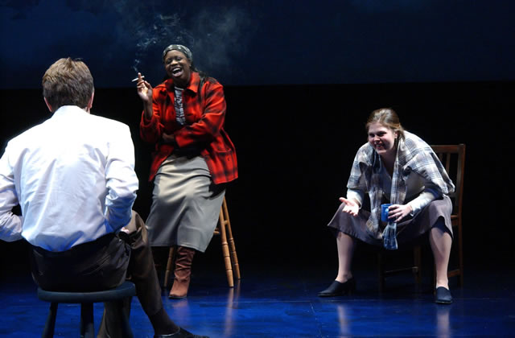
Realistic performance of monologues
This is one method of creating Verbatim theatre
As seen in-
The Laramie Project, Vagina Monologues, A State Affair, Talking To Terrorists
All these plays use a small cast
Who multi-role as the several
Subjects who were interviewed.
The same can also be done with one actor playing all the parts.
http://www.youtube.com/watch?v=z1RHg7bbfE8
Film of the laramie project (this is the whole film, its amazing- very sad-
http://www.youtube.com/watch?v=u1qiTmF0p4A

Slide 11
Present it using Choral Speech
Then using same 5 lines create something using choral movement/ speech.
Repeat/ echo at least 2 things and all move as an ensemble at least twice.

Slide 12
Ensemble/ choral performance
As seen in-
Too Much Punch for Judy, SOLD
These tend to also use projection
SOLD- http://www.youtube.com/watch?v=HqAaV6GyQFQ&safe=active

Slide 13
Montage/ overlapping dialogue
As in the clip from Sold read different extracts from the speeches and overlap them. Vary volume/ languages/ pace. See what effect this creates.
Try and do something physical with this- does not need to be super abstract, but have a visual element.

Slide 14
Physical Theatre
https://www.youtube.com/watch?v=0_MiU6ucj60&safe=active
http://www.youtube.com/watch?v=5NlOPzP4UM8
Physical Theatre – DV8
As seen in-
To Be Straight with You, Can we talk about this?

Slide 15
Introduce Woolwich text here
Notes:
There are slides after this, but they are probably less useful than getting into the nitty gritty of acting out the Lee Rigby text.
Use both proectors and encourage both groups to include multi-media

Slide 16
The Trouble with Asian Men
http://www.youtube.com/watch?v=6fccR60NJyM

Slide 17
Headphone Verbatim
The text comes into your ear just before you say the line
You would have rehearsed with this too, so that you are prepared for what is coming
It ensures you have the exact same speech pattern as the subject you are re-enacting- You have probably never seen the text written down.
Masterclass- http://www.youtube.com/watch?v=ULHkrMjtrZM

Slide 18
Composite character
Get the interviews you did not use before, and select to best 2 lines from each one and make it into one monologue.
This creates a composite character, this is a character that represents several characters at once. – it may be several people who live on the same street, or several members of a class. The dialogue is all still verbatim- just several people become one representational character.
A State Affair- http://www.youtube.com/watch?v=iXKl05XzYzk

Slide 19
Gathering text
Interview by the actor/ director/ writer
Youtube,
Television programs (question time, news, reality TV- anything where people are not acting),
Newspaper articles,
Blogs
Court transcripts
Tweets (good for a montage)
The key is to find someone being real and genuine, anything where it is composed as a character is not verbatim theatre, it has to be the real words of a real person.

Slide 20
How do you turn that into a play?
This is the opening page of ‘The Laramie Project’- where its writer explains it a little.

Slide 21
Videos (if you wish to watch them later)
Anna Deavere Smith is probably the leading figure in Verbatim theatre, she creates One Woman shows from the text she gathers from interview.
Fires in the Mirror
http://www.youtube.com/watch?v=hnkrUJny0CE
Let Me Down Easy
http://www.youtube.com/watch?v=uQ1OyKy9FwM
Others
Feelgood (slavery)- http://www.youtube.com/watch?v=ms4iYsOjEqg
Colour of Justice (Stephen Lawrence)- http://vimeo.com/28852588
One in Five (hysterectomy)- http://www.youtube.com/watch?v=jp8HK2TZHxs
Playlist of other plays (that I haven’t seen)- http://www.youtube.com/playlist?list=PL67E8157D8BE43160

